Slide 1
Review: Midterm
Buy and sell securities:
  Order: market, limited, stop loss…
  Margin purchase:
    Margin call: no interests considered
    Returns: interests
  Short sale:
    Margin call:
    Returns: borrow shares, not cash

Slide 2
Riskless securities
Yield to maturity
Spot rate
Forward rate
Discounted factor

Slide 3
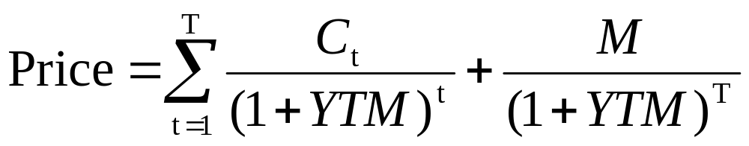
YTM

Slide 4
Relationship
YTM
Ci = 0
Spot rate
si
Forward
fi,j
(1+sj)^{j} =(1+si)^{i} (1+fi,j)^{j-i}
DF
DFi=1/(1+si)^{i}

Slide 5
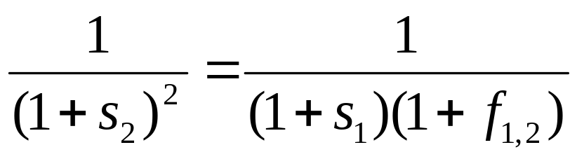
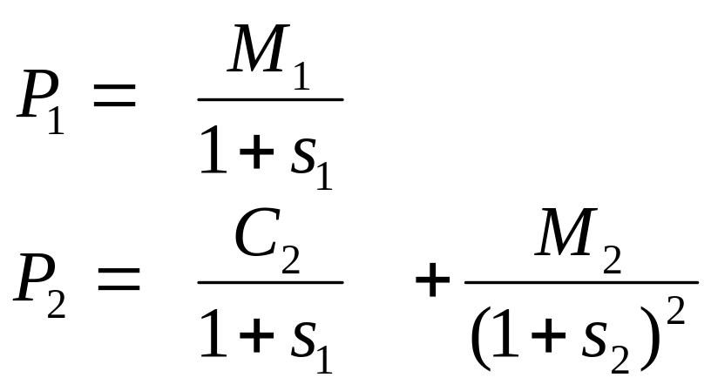
Application

Slide 6
Risk
Return + Risk
Always write down return first
Differences:
  Know the probability of future outcomes, calculate the expected return and variance
  Know individual security’s expected return and variance, calculate the portfolio’s

Slide 7









Portfolio
Variance-covariance matrix
 | Stock 1 | Stock 2 | Stock 3
Stock 1
Stock 2
Stock 3

Slide 8
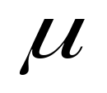

Mean-Variance Analysis
Efficient Set
Tangency
portfolio

Slide 9
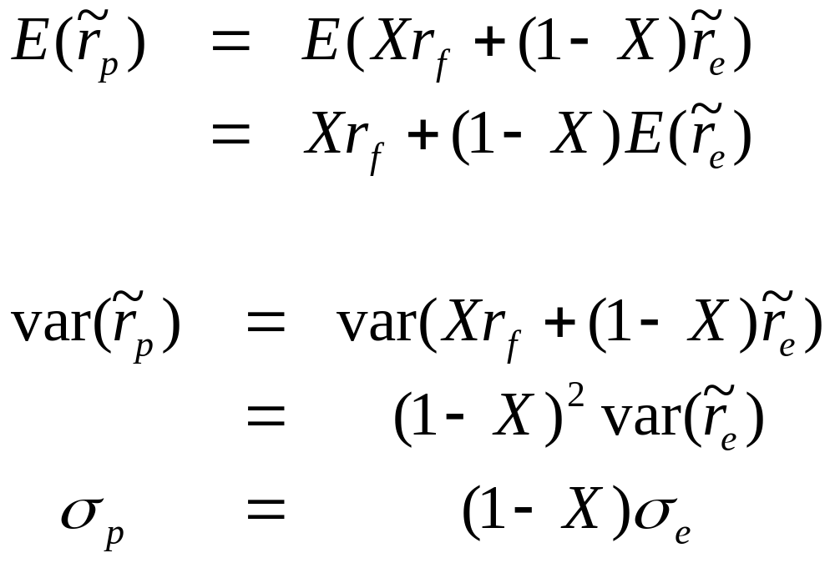
Efficient portfolio

Slide 10
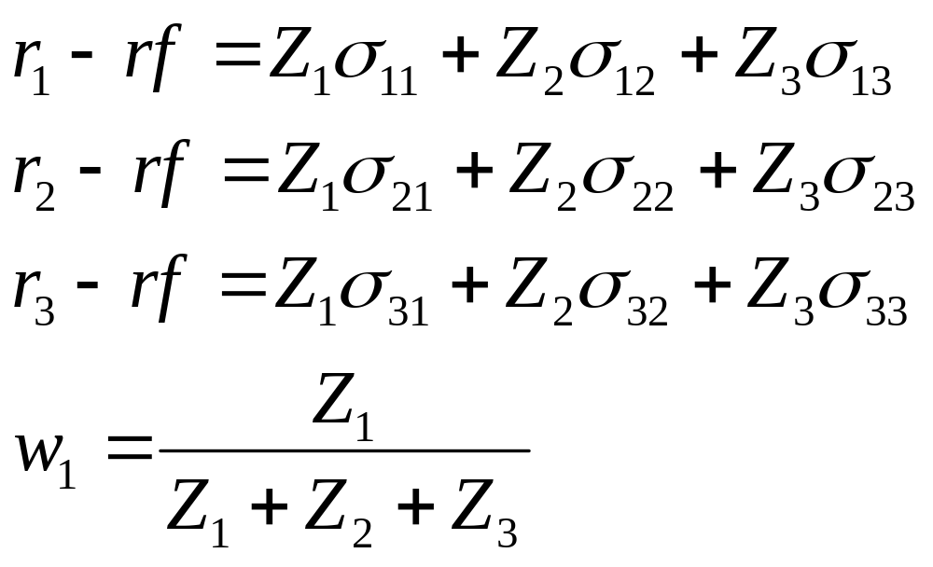

Slide 11
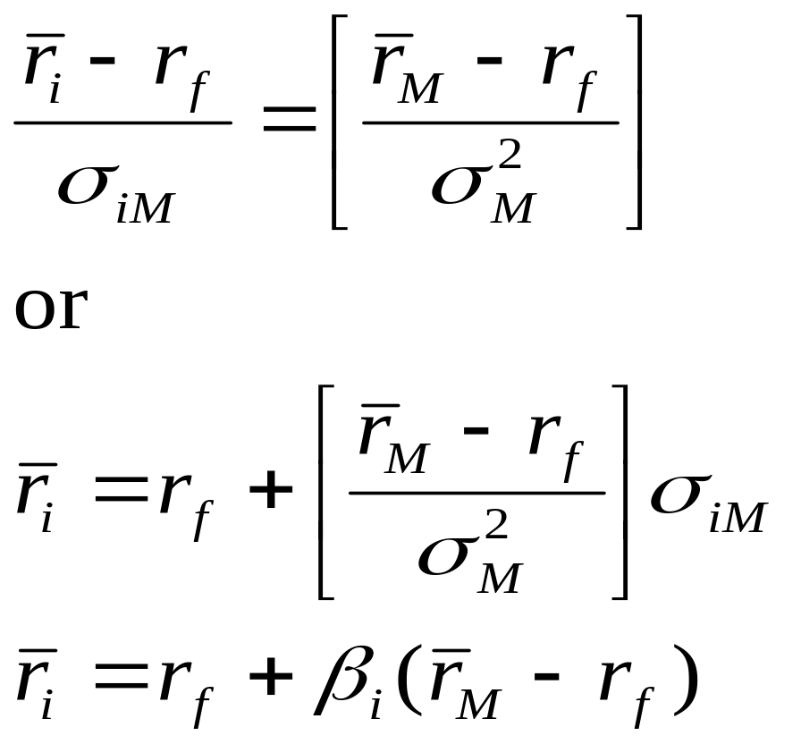
CAPM

Slide 12
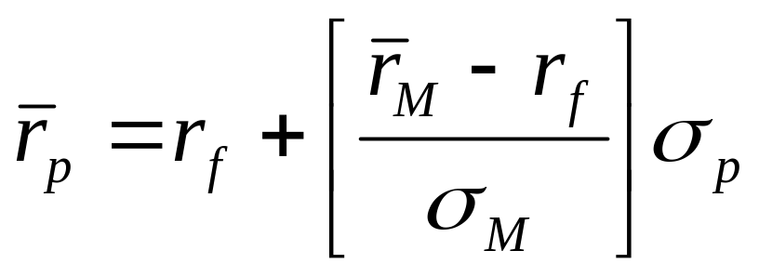
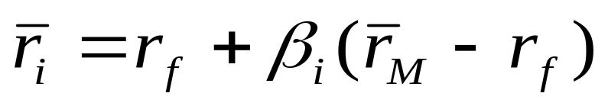
Two lines
Capital market line:
Security market line:

Slide 13
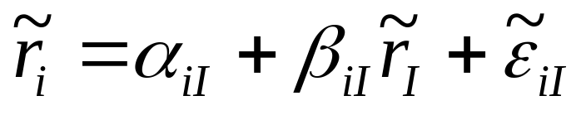
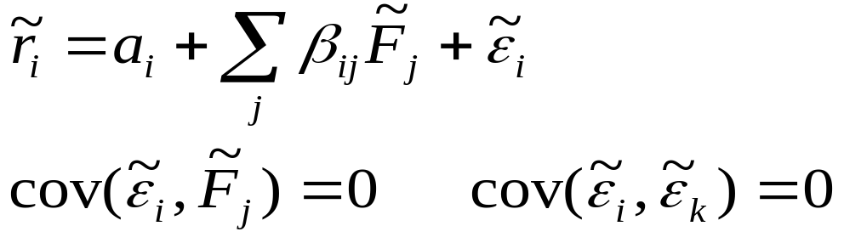
Factor model
One factor model:
  Market model
General

Slide 14
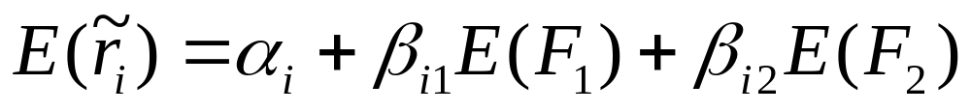
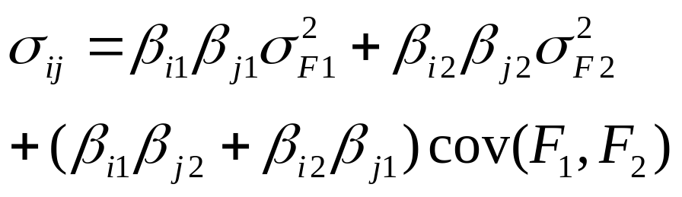
Two factor model
Expected return:
Variance
Covariance

